Slide 1
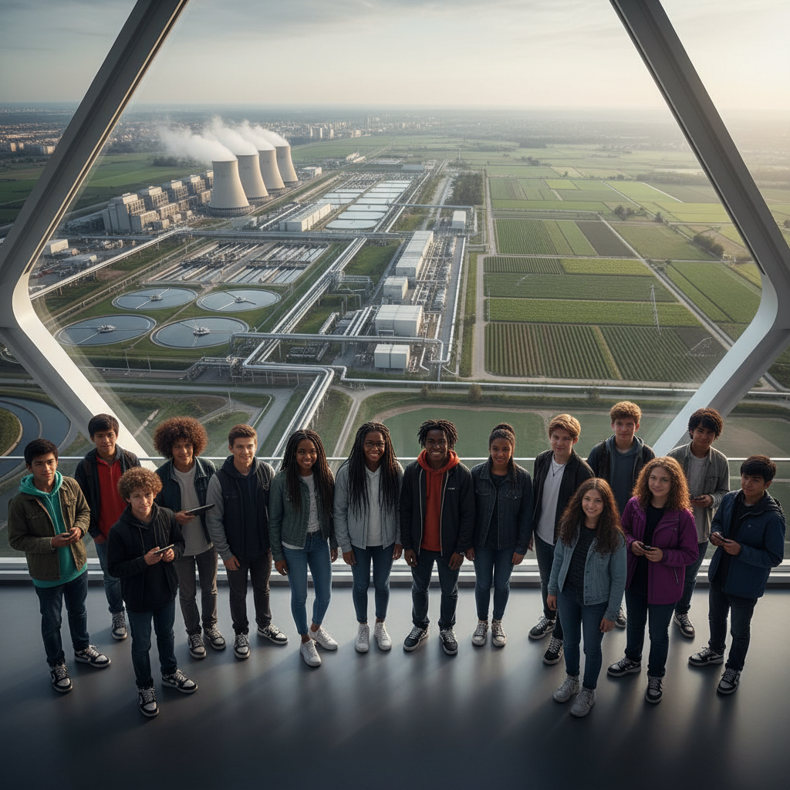
ModelIt!
Student Lesson
The Water-Energy-Food Nexus: Three Crises, One System
Modeling Coupled Resource Systems Under Population Pressure
NGSS: HS-ESS3-4, HS-ETS1-2
9th Grade — Level 2: Advanced
1/9

Slide 2
What You Will Learn Today
Learning Goals
* Model how water, energy, and food production systems are interconnected through feedback loops
* Analyze trade-offs that occur when optimizing one resource at the expense of others
* Evaluate how population growth amplifies stress across all three coupled systems
* Design sustainable resource management strategies that balance competing demands
Key Vocabulary
Nexus Thinking
An analytical approach that considers the interconnections between water, energy, and food systems rather than managing them in isolation
Resource Trade-off
A situation where increasing the supply of one resource requires consuming more of another, creating competition between systems
Carrying Capacity
The maximum population that a region can sustain given its water, energy, and food production capabilities
Circular Economy
An economic system that minimizes waste by recycling outputs from one process as inputs to another
2/9

Slide 3

The Big Question
Why does solving one resource crisis often make another worse?
Modeling Coupled Resource Systems Under Population Pressure. Today we'll build a MODEL to discover the answer!
3/9

Slide 4

Today We Will Build a Model!
A model helps us understand complex systems!
1. LOCATE
Identify the COMPONENTS (parts) of the system
2. ESTABLISH
Connect them with RELATIONSHIPS (+ or -)
3. VISUALIZE
Build your model in ModelIt!
4. EVALUATE
Run SIMULATIONS to test scenarios
5. REVISE
Improve your model based on evidence
4/9

Slide 5

Activity 1: Sort the Components
Sort these components into EXTERNAL (inputs from outside) and INTERNAL (inside the system):
Your Components:
* Water Availability
* Energy Production
* Agricultural Output
* Population Demand
* Industrial Usage
* Wastewater Recycling
Think: Which components can we control? Which happen on their own?
5/9

Slide 6
Activity 2: Connect with Arrows
Draw arrows to show HOW components affect each other:
(+) POSITIVE Relationship
When one goes UP, the other goes UP too
(-) NEGATIVE Relationship
When one goes UP, the other goes DOWN
Think About It:
If you increase Energy Production to meet Population Demand, what happens to Water Availability? If Water drops, what happens to Agricultural Output? How do you solve all three simultaneously?
6/9

Slide 7
Activity 3: Run the Simulation!
Test these scenarios in ModelIt!
Growing City
Increase Population Demand steadily -- observe cascading effects on all resources
Drought Conditions
Reduce Water Availability sharply -- track which systems fail first
Recycling Investment
Increase Wastewater Recycling to maximum -- observe how circular approaches help
Watch the activity graphs change!
[ModelIt Platform Screenshot - Simulation Results Graph]
7/9

Slide 8
What Did We Discover?
Our Model Showed Us:
* Water, energy, and food systems are so interconnected that solving one crisis in isolation can worsen the others
* Energy production is the largest industrial water consumer -- power plants use more water than agriculture in many regions
* Population growth creates compounding pressure because each additional person demands ALL three resources simultaneously
* Circular economy approaches like wastewater recycling can partially decouple the systems and reduce competition
Answer: Solving one crisis worsens another because water, energy, and food systems share the same finite resources. Growing more food requires more water AND more energy for irrigation. Producing more energy requires water for cooling. Increasing water treatment requires energy. Population growth multiplies all demands simultaneously. Only integrated nexus thinking that optimizes all three systems together can avoid the trap of solving one problem by creating two more.
8/9

Slide 9

STEM Challenge: Design a Sustainable City Resource Plan
YOUR ENGINEERING MISSION
Design an integrated water-energy-food management plan for a growing city that avoids resource trade-off traps.
The Challenge:
A city of 2 million is expected to grow to 3 million in 15 years. Water supply is already strained, energy costs are rising, and surrounding farmland is being developed. Design a plan that meets all three resource needs sustainably.
Think Like an Engineer:
* Which resource bottleneck will hit first given current growth trends?
* How can circular economy approaches reduce resource competition?
* What trade-offs are you willing to accept in your plan?
REAL CAREER CONNECTION: Environmental Systems Engineers design integrated resource management solutions for cities and regions, earning $65,000-$130,000/year at consulting firms, utilities, and government agencies. The skills you're using TODAY are the same ones they use on the job!
9/9

